Slide 1
Screening for and Responding to Participant Distress
In the Global Early Adolescent Study
The Global Early Adolescent Study: Participant Distress

Slide 2
Some adolescents in the world live under very difficult and stressful situations
E.g. Poor housing, hunger, exposure to trauma, substance abuse etc.
We do not expected that the GEAS instrument will illicit distress, but if it does or if participants disclose distress or trauma on the survey
Want GEAS researchers to be prepared to handle them appropriately
Participant Distress
The Global Early Adolescent Study: Participant Distress

Slide 3
What in the survey may cause distress?
Interpersonal Violence
Adverse Childhood Experiences
Fear of physical abuse
Sexual abuse
Exposure to familial drug or alcohol abuse
Exposure to familial mental health problems
Violence with romantic partners
Mental health
Depressive symptoms
Self-harm ideation
Anxiety
The Global Early Adolescent Study: Participant Distress

Slide 4
Response Opportunities
Provide Information and Referrals
Survey Flags
Reporting
The Global Early Adolescent Study: Participant Distress

Slide 5
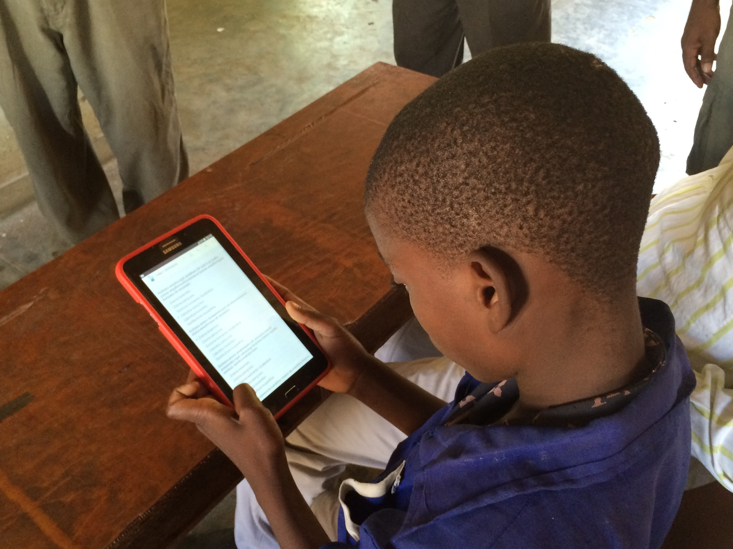
Tablet-based data collection
The Global Early Adolescent Study: Participant Distress

Slide 6
Provide Opportunity for All to Connect to Resources
Is there anything you are going through or dealing with that you would like discuss with someone?
Data collector provides information sheet with referral to counselor, child protection agency, or other predetermined entity
☒ Yes
☐ No
The Global Early Adolescent Study: Participant Distress

Slide 7
Survey Flags (Survey CTO Only)
Data collector is notified of the disclosed experiences at conclusion of the survey
Have you experienced…
Self-harm ideation
Fear of physical abuse
Parental drug/alcohol abuse
Molestation
Sexual assault
Data Collector notifies Site PI
Criteria customized by sites
Site PI or their designee attempts to follow-up with participant: “We’d like to follow up with you about some of the experiences you noted on the survey.”
Site PI collects more information about severity of incident and time period. Site PI provides a supported referral process to services.
Adolescent maintains right to refuse at any time, unless s/he is current in danger.
☒ Yes
☐ No
The Global Early Adolescent Study: Participant Distress

Slide 8
Reporting
IRB
Legally mandated reporting (according to local laws)
Data Collector
Site PI
GEAS Study PI
JHSPH IRB
The Global Early Adolescent Study: Participant Distress
Notes:
Specifically around reporting severe events that arise when following up with participants
-Situations when participant is in danger (e.g. abusive household, relationship situation)
-Participant Death

